Slide 1

Introduction to Artificial Intelligence

Slide 2
About the module...
Lecturers: Dan Magazzeni and Lela Koulouri
Reading:
Artificial Intelligence - A Modern Approach (3rd edition) Stuart Russell and Peter Norvig, Prentice Hall Series in AI
Other papers suggested by lecturer
All the slides and notes on KEATS
Lectures start at 10.10am !
Office Hours: 14:00-16:00 Tuesdays or by appointment (my office is S6.19, Strand Campus, 6th Floor)
Assessment:
15%+15%: Coursework
70%: Exam
Coursework: develop your own AI application!

Slide 3
About the module...
Graph search
Heuristic Search
Problem Modelling
Machine Learning
Neural Networks
Artificial Intelligence Planning
Constraint Satisfaction Problem (CSP)

Slide 4
Introduction to Artificial Intelligence
Solving Problems by Searching

Slide 5
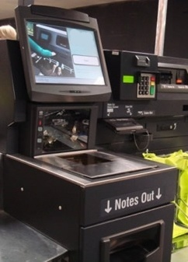
First example: self-service checkout
Two problems:
Machine-side: give the exact change (minimising number of coins...)
Customer-side: pay the exact price (maximising number of coins…)

Slide 6
First example: self-service checkout
Two problems:
Machine-side: give the exact change (minimising number of coins...)
Simple strategy?

Slide 7
First example: self-service checkout
Two problems:
Machine-side: give the exact change (minimising number of coins...)
Simple strategy:
-always use the highest-value coin that does not
exceed the change to be given
Example: change = £ 4.76

Slide 8
First example: self-service checkout
Two problems:
Machine-side: give the exact change (minimising number of coins...)
Simple strategy:
-always use the highest-value coin that does not
exceed the change to be given
Example: change = £ 4.76
£2

Slide 9
First example: self-service checkout
Two problems:
Machine-side: give the exact change (minimising number of coins...)
Simple strategy:
-always use the highest-value coin that does not
exceed the change to be given
Example: change = £ 4.76
£2+£2

Slide 10
First example: self-service checkout
Two problems:
Machine-side: give the exact change (minimising number of coins...)
Simple strategy:
-always use the highest-value coin that does not
exceed the change to be given
Example: change = £ 4.76
£2+£2+50p

Slide 11
First example: self-service checkout
Two problems:
Machine-side: give the exact change (minimising number of coins...)
Simple strategy:
-always use the highest-value coin that does not
exceed the change to be given
Example: change = £ 4.76
£2+£2+50p+20p

Slide 12
First example: self-service checkout
Two problems:
Machine-side: give the exact change (minimising number of coins...)
Simple strategy:
-always use the highest-value coin that does not
exceed the change to be given
Example: change = £ 4.76
£2+£2+50p+20p+5p

Slide 13
First example: self-service checkout
Two problems:
Machine-side: give the exact change (minimising number of coins...)
Simple strategy:
-always use the highest-value coin that does not
exceed the change to be given
Example: change = £ 4.76
£2+£2+50p+20p+5p+1p (optimal solution)

Slide 14
First example: self-service checkout
Two problems:
Machine-side: give the exact change (minimising number of coins...)
Simple strategy:
-always use the highest-value coin that does not
exceed the change to be given
Example: change = £ 4.76
£2+£2+50p+20p+5p+1p (optimal solution)
...unfortunately, machines need to save space, then they will give you a lot of coins...

Slide 15
First example: self-service checkout
Two problems:
Customer-side: pay the exact price (maximising number of coins…)
Symmetric strategy?
-always use the lowest-value coin that does not
exceed the change to be given
-it does not work, as it depends on how
many coins the customer has got

Slide 16
First example: self-service checkout
Two problems:
Customer-side: pay the exact price (maximising number of coins…)
Example price = £ 4.76
3 x 1p
3 x 2p
0 x 5p
1 x 10p
3 x 20p
0 x 50p
3 x £1
1 x £2
1p+1p+1p+2p+2p+2p+10p+20p+20p+20p+£1+£1+£1 = £3.79
1p+1p+1p+2p+2p+2p+10p+20p+20p+20p+£1+£1+£1+£2= £5.79
1p+1p+2p+2p+10p+20p+20p+20p+£1+£1+£2 = £ 4.76

Slide 17
Problem Formulation
Model description:
The initial state
Set of actions
The transition function
The goal state
The cost function

Slide 18
Problem Formulation
Model description for the customer
The initial state
total: 0
#1p : 3
#2p : 3
#5p : 0
#10p : 1
#20p : 3
#50p : 0
# 1£ : 3
# 2£ : 1

Slide 19
Problem Formulation
Model description for the customer
The set of actions
insert(1p)
insert(2p)
insert(5p)
insert(10p)
insert(20p)
insert(50p)
insert(1£)
insert(2£)

Slide 20
Problem Formulation
Model description for the customer
The set of actions Preconditions
insert(1p)
insert(2p)
insert(5p)
insert(10p)
insert(20p)
insert(50p)
insert(1£)
insert(2£)

Slide 21
Problem Formulation
Model description for the customer
The set of actions Preconditions
insert(1p) #1p > 0
insert(2p) #2p > 0
insert(5p) #5p > 0
insert(10p) #10p > 0
insert(20p) #20p > 0
insert(50p) #50p > 0
insert(1£) #1£ > 0
insert(2£) #2£ > 0

Slide 22
Problem Formulation
Model description
The transition function F
F(state,insert(1p)):
total = total + 1p
#1p = #1p - 1
…
…
F(state,insert(2£)):
total = total + 2£
#2£ = #2£ - 1

Slide 23
Problem Formulation
Model description
The goal state
total >= £ 4.76 (price)
(why not total = £4.76?)
The cost function
(# coins at the end)

Slide 24
Problem Formulation
Model description
A solution to a problem is an action sequence that leads from the initial state to the goal state
An optimal solution is the solution with the lowest (highest) cost function

Slide 25
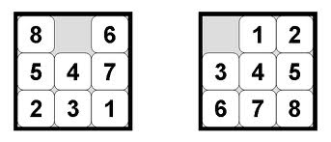
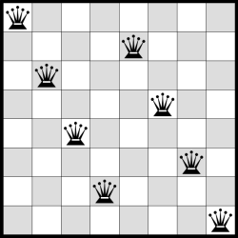
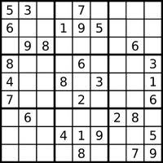
Other examples
The 8-puzzle
The 8-queens problem
Sudoku
Travelling salesman problem
...

Slide 26
Graph Search (searching for solutions...)

Slide 27
Graph search
0
3,3,0,1, 3,0,3,1
root node = initial state
The initial state
total: 0
#1p : 3
#2p : 3
#5p : 0
#10p : 1
#20p : 3
#50p : 0
# 1£ : 3
# 2£ : 1

Slide 28
Graph search
Let’s expand the current state
0
3,3,0,1, 3,0,3,1
root node = initial state
The set of actions Preconditions
insert(1p) #1p > 0
insert(2p) #2p > 0
insert(5p) #5p > 0
insert(10p) #10p > 0
insert(20p) #20p > 0
insert(50p) #50p > 0
insert(1£) #1£ > 0
insert(2£) #2£ > 0

Slide 29
Graph search
edge
0
3,3,0,1, 3,0,3,1
1p
1
2,3,0,1, 3,0,3,1
parent node
child node

Slide 30
Graph search
0
3,3,0,1, 3,0,3,1
Level 0
1p
2p
£1
£2
10p
20p
1
2,3,0,1, 3,0,3,1
2
3,2,0,1, 3,0,3,1
10
3,3,0,0, 3,0,3,1
20
3,3,0,1, 2,0,3,1
100
3,3,0,1, 3,0,2,1
200
3,3,0,1, 3,0,3,0
Level 1

Slide 31
Graph search
0
3,3,0,1, 3,0,3,1
1p
2p
£1
£2
10p
20p
1
2,3,0,1, 3,0,3,1
2
3,2,0,1, 3,0,3,1
10
3,3,0,0, 3,0,3,1
20
3,3,0,1, 2,0,3,1
100
3,3,0,1, 3,0,2,1
200
3,3,0,1, 3,0,3,0
Is there a goal state ?
No
Expand a new state
Which one ?

Slide 32
Graph search
0
3,3,0,1, 3,0,3,1
1p
2p
£1
£2
10p
20p
1
2,3,0,1, 3,0,3,1
2
3,2,0,1, 3,0,3,1
10
3,3,0,0, 3,0,3,1
20
3,3,0,1, 2,0,3,1
100
3,3,0,1, 3,0,2,1
200
3,3,0,1, 3,0,3,0

Slide 33
Graph search
0
3,3,0,1, 3,0,3,1
1p
2p
£1
£2
10p
20p
1
2,3,0,1, 3,0,3,1
2
3,2,0,1, 3,0,3,1
10
3,3,0,0, 3,0,3,1
20
3,3,0,1, 2,0,3,1
100
3,3,0,1, 3,0,2,1
200
3,3,0,1, 3,0,3,0
2
3
11
21
101
201

Slide 34
Graph search
0
3,3,0,1, 3,0,3,1
1p
2p
£1
£2
10p
20p
1
2,3,0,1, 3,0,3,1
2
3,2,0,1, 3,0,3,1
10
3,3,0,0, 3,0,3,1
20
3,3,0,1, 2,0,3,1
100
3,3,0,1, 3,0,2,1
200
3,3,0,1, 3,0,3,0
2
3
11
21
101
201
leaf node
Frontier or Open List

Slide 35
Graph search
0
3,3,0,1, 3,0,3,1
1p
2p
1£
2£
10p
20p
1
2,3,0,1, 3,0,3,1
2
3,2,0,1, 3,0,3,1
10
3,3,0,0, 3,0,3,1
20
3,3,0,1, 2,0,3,1
100
3,3,0,1, 3,0,2,1
200
3,3,0,1, 3,0,3,0
2
3
11
21
101
201

Slide 36
Graph search
0
3,3,0,1, 3,0,3,1
1p
2p
£1
£2
10p
20p
1
2,3,0,1, 3,0,3,1
2
3,2,0,1, 3,0,3,1
10
3,3,0,0, 3,0,3,1
20
3,3,0,1, 2,0,3,1
100
3,3,0,1, 3,0,2,1
200
3,3,0,1, 3,0,3,0
2
3
11
21
101
201
3
4
12
22
102
202

Slide 37
Graph search
0
3,3,0,1, 3,0,3,1
1p
2p
1£
2£
10p
20p
1
2,3,0,1, 3,0,3,1
2
3,2,0,1, 3,0,3,1
10
3,3,0,0, 3,0,3,1
20
3,3,0,1, 2,0,3,1
100
3,3,0,1, 3,0,2,1
200
3,3,0,1, 3,0,3,0
2
3
11
21
101
201
3
4
12
22
102
202

Slide 38
Graph search
0
3,3,0,1, 3,0,3,1
1p
2p
1£
2£
10p
20p
1
2,3,0,1, 3,0,3,1
2
3,2,0,1, 3,0,3,1
10
3,3,0,0, 3,0,3,1
20
3,3,0,1, 2,0,3,1
100
3,3,0,1, 3,0,2,1
200
3,3,0,1, 3,0,3,0
2
3
11
21
101
201
4
12
22
102
202
Visited states or Closed List

Slide 39
Graph search
0
3,3,0,1, 3,0,3,1
1p
2p
£1
£2
10p
20p
1
2,3,0,1, 3,0,3,1
2
3,2,0,1, 3,0,3,1
10
3,3,0,0, 3,0,3,1
20
3,3,0,1, 2,0,3,1
100
3,3,0,1, 3,0,2,1
200
3,3,0,1, 3,0,3,0
2
3
11
21
101
201
20
30
110
210
4
12
22
102
202
Visited states or Closed List

Slide 40
Graph search
0
3,3,0,1, 3,0,3,1
1p
2p
£1
£2
10p
20p
1
2,3,0,1, 3,0,3,1
2
3,2,0,1, 3,0,3,1
10
3,3,0,0, 3,0,3,1
20
3,3,0,1, 2,0,3,1
100
3,3,0,1, 3,0,2,1
200
3,3,0,1, 3,0,3,0
2
3
11
21
101
201
30
40
110
210
120
220
4
12
22
102
202

Slide 41
Graph search
0
3,3,0,1, 3,0,3,1
1p
2p
£1
£2
10p
20p
1
2,3,0,1, 3,0,3,1
2
3,2,0,1, 3,0,3,1
10
3,3,0,0, 3,0,3,1
20
3,3,0,1, 2,0,3,1
100
3,3,0,1, 3,0,2,1
200
3,3,0,1, 3,0,3,0
2
3
11
21
101
201
30
40
110
210
120
220
200
300
4
12
22
102
202

Slide 42
Graph search
0
3,3,0,1, 3,0,3,1
1p
2p
£1
£2
10p
20p
1
2,3,0,1, 3,0,3,1
2
3,2,0,1, 3,0,3,1
10
3,3,0,0, 3,0,3,1
20
3,3,0,1, 2,0,3,1
100
3,3,0,1, 3,0,2,1
200
3,3,0,1, 3,0,3,0
2
3
11
21
101
201
30
40
110
210
120
220
200
300
4
12
22
102
202

Slide 43
Graph search
0
3,3,0,1, 3,0,3,1
1p
2p
£1
£2
10p
20p
1
2,3,0,1, 3,0,3,1
2
3,2,0,1, 3,0,3,1
10
3,3,0,0, 3,0,3,1
20
3,3,0,1, 2,0,3,1
100
3,3,0,1, 3,0,2,1
200
3,3,0,1, 3,0,3,0
2
3
11
21
101
201
30
40
110
210
120
220
200
300
4
12
22
102
202

Slide 44
Graph search
0
3,3,0,1, 3,0,3,1
1p
2p
£1
£2
10p
20p
1
2,3,0,1, 3,0,3,1
2
3,2,0,1, 3,0,3,1
10
3,3,0,0, 3,0,3,1
20
3,3,0,1, 2,0,3,1
100
3,3,0,1, 3,0,2,1
200
3,3,0,1, 3,0,3,0
1p
2p
2
3
11
21
101
201
30
40
110
210
120
220
200
300
1p
3
4
12
22
102
202
State variables
Total
#1p
#2p
#5p
#10p
#20p
#50p
# 1£
# 2£
Are they the same state?

Slide 45
Graph search
0
3,3,0,1, 3,0,3,1
1p
2p
£1
£2
10p
20p
1
2,3,0,1, 3,0,3,1
2
3,2,0,1, 3,0,3,1
10
3,3,0,0, 3,0,3,1
20
3,3,0,1, 2,0,3,1
100
3,3,0,1, 3,0,2,1
200
3,3,0,1, 3,0,3,0
1p
2p
2
3
11
21
101
201
30
40
110
210
120
220
200
300
1p
3
4
12
22
102
202
State variables
Total
#1p
#2p
#5p
#10p
#20p
#50p
# 1£
# 2£
total=3
#1p=0
#2p=3
…
…
total=3
#1p=2
#2p=2
…
…
≠

Slide 46
Search Algorithms Uninformed Search

Slide 47
Breadth-first search (BFS)
I
I
I
I
I
I
G
G
G
Generate all the children of the current node.
Expand nodes in the order that they were generated.

Slide 48
Depth-first search (DFS)
I
I
I
I
I
I
G
G
G
Generate the first child of the current node.
Expand it.
Backtrack to the most recent node with unexpanded children.

Slide 49
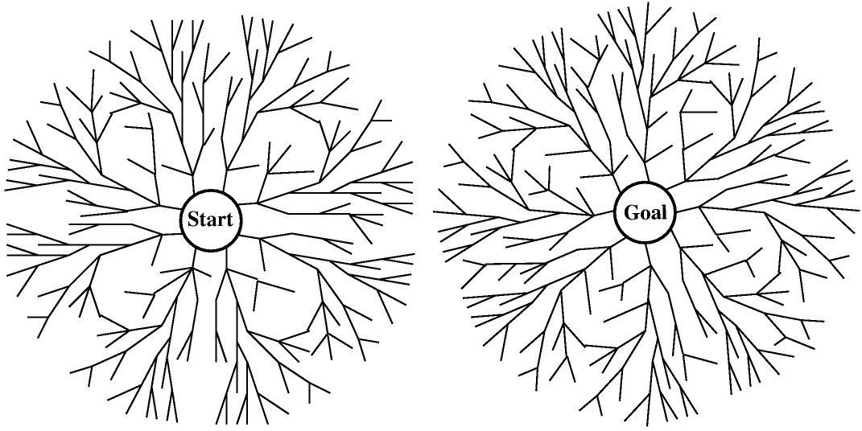
Bidirectional search

Slide 50
Properties of algorithms
Completeness: is the algorithm guaranteed to find a solution when there is one?

Slide 51
Properties of algorithms
Completeness: is the algorithm guaranteed to find a solution when there is one?
Optimality: does the algorithm find the optimal solution?

Slide 52
Properties of algorithms
Completeness: is the algorithm guaranteed to find a solution when there is one?
Optimality: does the algorithm find the optimal solution?
Time complexity: how long does it take to find a solution?

Slide 53
Properties of algorithms
Completeness: is the algorithm guaranteed to find a solution when there is one?
Optimality: does the algorithm find the optimal solution?
Time complexity: how long does it take to find a solution?
Space complexity: how much memory is needed to perform the search?

Slide 54
Properties of BFS ?
Completeness: is the algorithm guaranteed to find a solution when there is one?
Optimality: does the algorithm find the optimal solution?
Time complexity: how long does it take to find a solution?
Space complexity: how much memory is needed to perform the search?
BFS is:
complete
optimal IF all actions have the same cost
COMPLEX
Complexity is measured based on branching factor b
If the goal is at level d then the number of nodes is:
b + b² + b³ + … + b^{d}

Slide 55
Complexity is measured based on branching factor b
If the goal is at level d then the number of nodes is:
b + b² + b³ + … + b^{d}
b=2
0
I
I
1
I
I
I
I
1
2
2
4
3
G
8
G
G

Slide 56
Properties of BFS ?
Completeness: is the algorithm guaranteed to find a solution when there is one?
Optimality: does the algorithm find the optimal solution?
Time complexity: how long does it take to find a solution?
Space complexity: how much memory is needed to perform the search?
BFS is:
complete
optimal IF all actions have the same cost
COMPLEX
Depth | Nodes | Time | Memory
2 | 110 | .11 milliseconds | 107 kilobytes
4 | 11,110 | 11 milliseconds | 10.6 megabytes
6 | 10⁶ | 1.1 seconds | 1 gigabyte
8 | 10⁸ | 2 minutes | 103 gigabytes
10 | 10¹⁰ | 3 hours | 10 terabytes
12 | 10¹² | 13 days | 1 petabyte
14 | 10¹⁴ | 3.5 years | 99 petabyte
16 | 10¹⁶ | 350 years | 10 exabyte

Slide 57
The Key Challenge: Search Guidance
Lots of potential solutions.
Suppose:
20 actions to choose from,
Solution plan is 20 steps long.
Worst case: need to search through all 20^20 possibilities.
(> 1 with 26 zeros after, 10²⁶).
1.35*10¹⁰ is the estimated age of the universe so even at millions of states per second we can’t hope to explore it.
Need to find a way to search through only the most promising states.

Slide 58
Solving Problems by Searching (exercises)

Slide 59
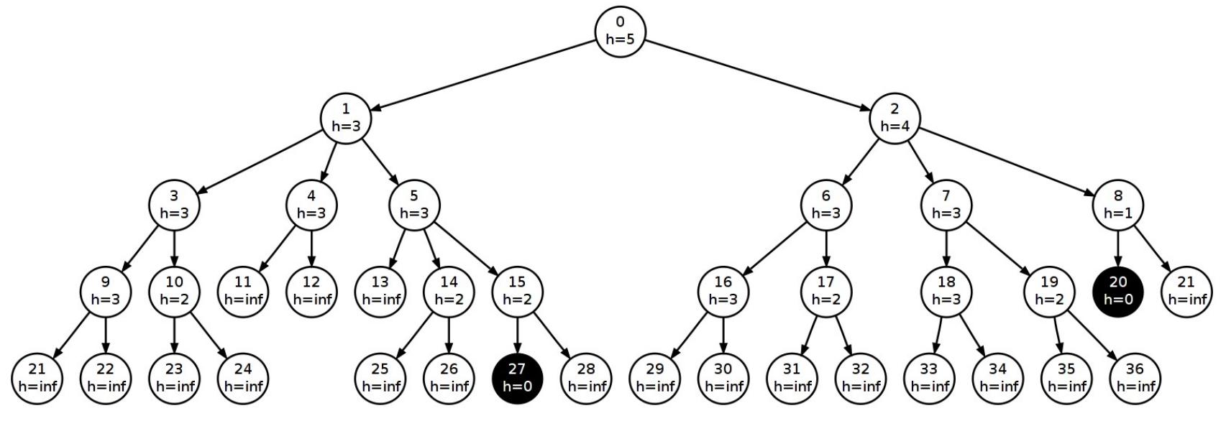
Exercise 2
3
2
2
1
 | Sequence of Nodes Expanded in Example | Goal found
Breadth-first search
Depth-first search

Slide 60
Exercise 2
3
2
2
1
 | Sequence of Nodes Expanded in Example | Goal found
Breadth-first search | 0,1,2,3,4,5,6,7,8,9,10,11,12,13,14,15,16,17,18,19,20 | 20
Depth-first search

Slide 61
Exercise 2
3
2
2
1
 | Sequence of Nodes Expanded in Example | Goal found
Breadth-first search | 0,1,2,3,4,5,6,7,8,9,10,11,12,13,14,15,16,17,18,19,20 | 20
Depth-first search

Slide 62
Exercise 2
3
2
2
1
 | Sequence of Nodes Expanded in Example | Goal found
Breadth-first search | 0,1,2,3,4,5,6,7,8,9,10,11,12,13,14,15,16,17,18,19,20 | 20
Depth-first search | 0,1,3,9,21,22,10,23,24,4,11,12,5,13,14,25, 26,15,27 | 27

